Slide 1

Soft skills in testing
By Cristian Muresan

Slide 2
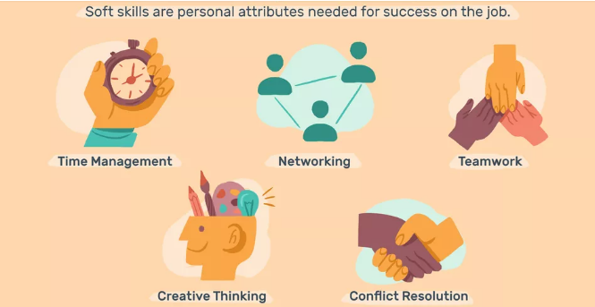
What are soft skills?
Soft skills are non-technical skills that relate to how you work. They include, how you interact with colleagues, how you solve problems and how you manage your work.

Slide 3

Top Soft skills for testing
Once you realize the importance of soft skills to being a great tester, leader, or team player, you will definitely love to develop your soft skills. Bellow we’ll present you some of the most important soft skills needed to be a good tester.

Slide 4

Communication
One of the most important skills is healthy communication. As a software tester or leader, you need to communicate in a manner that both technical and non-technical people can easily understand. This is always a two way process – listening is as important as speaking. You must not only advise others but learn to listen to others perspective as well.

Slide 5

adaptability
The market and business change constantly. The project requirements can be also changed and the timeline is adjusted. That’s why having soft skills or improving them helps you to adept quickly to any situation and become a strong team player.

Slide 6

prioritization
This skill is linked to the above mentioned one. The tasks can be endless but still they are to be done. If a tester wants to be proactive, work efficiently and get results, then is critical to be highly organized, plan ahead and get priorities right.

Slide 7

Teamwork
Team work is required for almost every industry. If you want to work well with colleagues, teamwork is essential. The better you work with the others, the more successful your team will be in completing tasks.

Slide 8

Work ethic
Work ethic is one of the most important soft skills to have. Such testers come to work on time, stay focused, complete tasks promptly and stay organized.

Slide 9

Critical thinking
Critical thinking it is crucial for software testing. Always looking for the root of the problem, know what questions to ask. Some testers have it as a gift, others can work on this ability.

Slide 10

Decision-making
Lots of questions are discussed with the teammates, clients on meetings, and you choose the most efficient solution. However a situation can occur when you have no time to consult with anybody and you have to take a decision.

Slide 11

Fast learning and want-to-learn attitude
New technologies, methods, techniques, features and more are to be learned in case you wish to be a good tester. Nothing will happen if you don’t want to.

Slide 12

conclusion
With quality becoming a part of every step of the application lifecycle, even if you choose an entirely technical track in your career, you’ll need the soft skills above to become a effective team player and work well within the organization.

